Slide 1

Take a Hike!
Parks, Trails, and Scenic Routes in Pacifica Bay

Slide 2

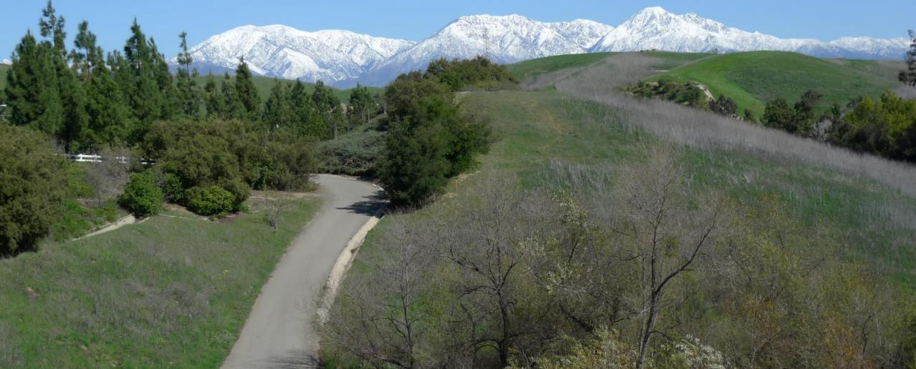
Improve your physical fitness by exploring Pacifica Bay’s many paths, trails, and parks.

Slide 3
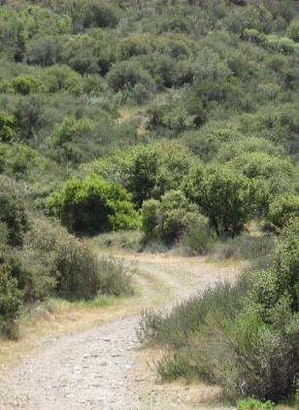
It’s a Great Way To. . .
Improve your cardiovascular fitness
Learn about local vegetation and wildlife
Get outside and meet your neighbors

Slide 4
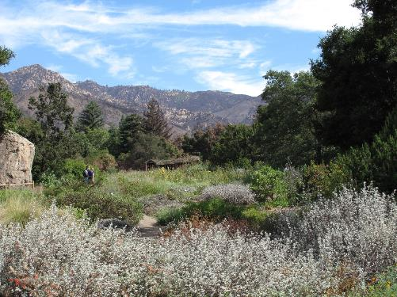
Challenge Yourself on a Wilderness Hike
Over 25 miles in the 10, city-maintained trails
Restroom facilities available
Wildlife abounds so be aware of surroundings
Maintained trails can be slippery and hot
Bring adequate sun protection and hydration

Slide 5
Set a Pace Based on Your Fitness Level
Easy
Oceana Beach Trail
Moderate
Monte Vista Park
Hidden Trail Park
Crossroads Park
Challenging
Pacifica Bay State Park
Bayside Beach Trail

Slide 6
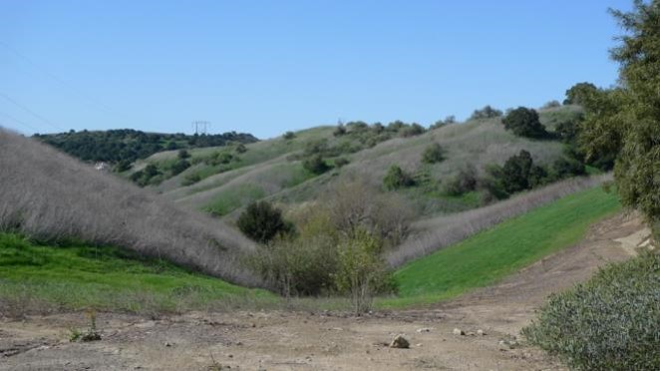
For Information on Maintained Trails, Contact Parks and Recreation

